Slide 1
Effective Credentialing, Privileging & Enrolling Clinicians
Cred2bill team has implemented customized versions to meet your organizational needs and culture
Accountable
Responsible
Authorized

Slide 2
Current State - Provider
Credentialing
Recruitment
Clinician
Coding/Billing
Enrollment
Practice Readiness
Onboarding
MEC/Board
Clinical/Quality

Slide 3
Who should be part of this…. Be effective and seamless
Recruitment / Contracts
Technology / Coding/Billing
Onboarding / Navigation
Clinician
Practice Readiness Mentors
Credentialing Hospital/Payer

Slide 4
Cred2bill does what?
Who are Cred2bill?
Proactive, problem solvers
Help facilitate collaboration, mutual respect and find common ground
If you include us in your planning, we might be able to suggest alternate methodologies to help expedite any bottle necks – just maybe
Be your voice, where and when needed
Medical Staff: – credentialing and privileging for hospitals
Payer Enrolment: commercial and non-commercial payers
FPPE, OPPE, Professionalism and Clinical Competency
Legal and Compliance: Bylaws, policies, Joint Commission and CMS as it relates to Medical Staff standards

Slide 5
Payer Enrollment
Commercial Payer Applications – Initial & Recredentialing
Medicare Applications – Initial and Revalidations
Medicaid Applications – Initial and Revalidations
Contracts and claim reviews
Commercial payer rosters & Demographic Maintenance
About Us
What do we do?
Payer Enrollment

Slide 6
Medical Staff Services
Credentialing and privileging for hospitals and practices, build privilege forms and streamline process
Peer Review, FPPE, OPPE, Professionalism standards and Clinical Competency
Legal and Compliance, bylaws, policies, Joint Commission and CMS standards
Train new MSS leaders on fiduciary responsibilities
Assess internal processes, technology, competency and submit a gap analysis – based on Lean concepts
STANDARDIZE across the entire system
About Us
What do we do?
Medical Staff Services

Slide 7
When does Onboarding Begins?
As soon as the provider has given a verbal consent – Hiring team
If you wait for contract to be signed, the provider has lost time to be on-boarded – Legal/Contract team
60-75 days to process a file prior to Credentials Committee
Takes 90-120 days for a health plans to approve an application
CAQH must be updated prior to submitting any health plan applications – intake form to be completed by recruiters
Objective: Enrollment effective date MUST be start date – Mcare/Mcaid

Slide 8
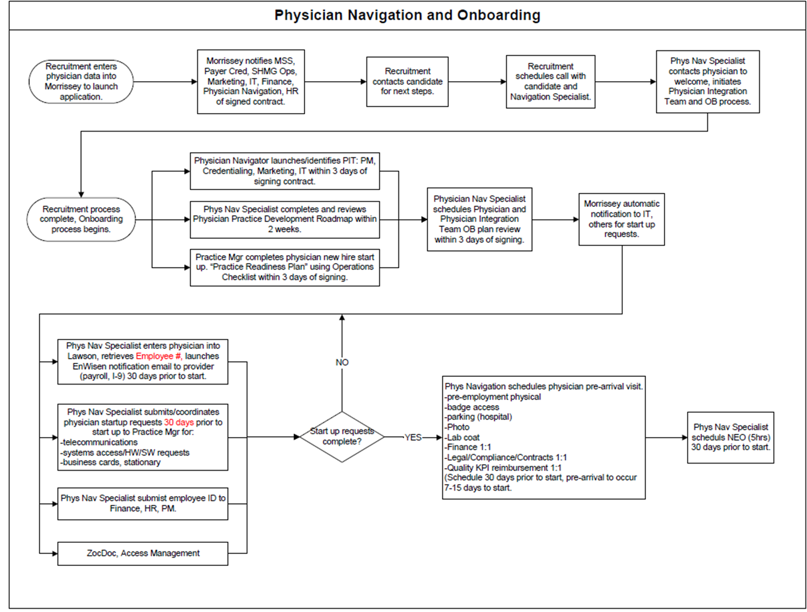
Example of implemented process

Slide 9
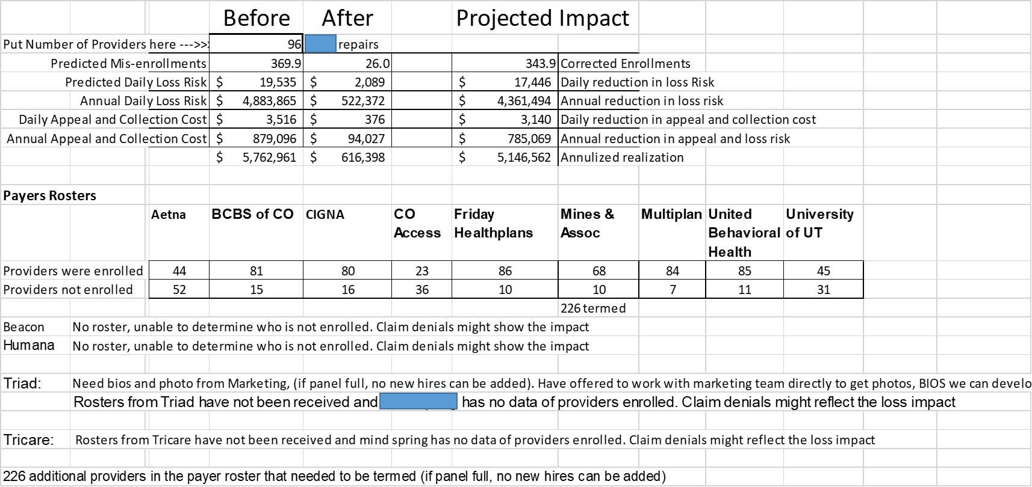
Example of Cred2bill impact on payer enrollment

Slide 10
Turnaround Times in 2019 for Client A
87 days from initial hire notification- to a complete file (Mar–Oct 2019)
23 days to get Medicaid approval for the same provider (Mar – Oct 2019)
64 days of missed Medicaid revenue
Excluding initial 120 providers that were on-boarded
How many new hires?
In 2019 - 27 new hires. In 2020 - 8 new hires. (Jan and Feb 2020 numbers)
How many terms?
In 2019 - 32. In 2020 - 6. . (Jan and Feb 2020 numbers)
Lack of termed provider notification impacts panels being full & new providers being denied
Since November of 2019, the average number of days from notification to provider profile complete is 26 days vs 87 days
Efficiencies gained thru process improvement and collaboration
Timely capture of provider data on offer acceptance will impact this turnaround time

Slide 11
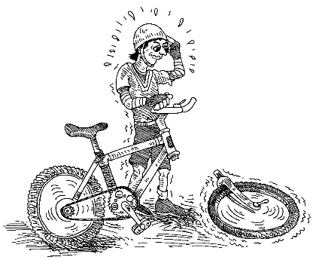
Did you know?
Do not have to be credentialed to orient and train
Temporary privileges – need a valid reason and cannot have red flags
Unable to plan ahead is not a reason for urgent requests
Communicate with us, we are here to help, seriously!
New practice? New location? Change from Hospital based to … Pertinent and Critical!!!
Enrollment and Billing … if not done right the first time

Slide 12
Quality and Competency
Accountable
Responsible
Authorized

Slide 13
Competency and Quality Management
Peer Review, FPPE and OPPE are the pillars on which patient care stands
The primary objectives of the Peer Review aka Professional Practice Evaluation (“PPE”) process is to:
Establish a positive, educational approach to performance issues and a culture of continuous improvement for individual practitioners, which includes:
fairly, effectively, and efficiently evaluating the care being provided by practitioners, comparing it to established patient care protocols and benchmarks whenever possible; and
providing constructive feedback, education, and performance improvement assistance to practitioners regarding the quality, appropriateness, and safety of the care they provide;
Effectively disseminate lessons learned and promote education sessions so that all practitioners in a relevant specialty area will benefit from the PPE process and also participate in the culture of continuous improvement; and
Promote the identification and resolution of system process issues that may adversely affect the quality and safety of care being provided to patients (e.g., protocol or policy revisions that are necessary; addressing patient handoff breakdowns or communication problems).

Slide 14
Components of peer review
There are several related but distinct components:
The PPE process is used when questions or concerns are raised about a practitioner’s Professionalism and/or Clinical competence. This process has traditionally been referred to as “peer review.”
The process used to confirm an individual’s competence to exercise new privileges is the Focused Professional Practice Evaluation (FPPE) Policy.
The process used to evaluate a practitioner’s competence on an ongoing basis is in the Ongoing Professional Practice Evaluation (OPPE) Policy.
Concerns regarding a practitioner’s professional conduct or health status shall be reviewed in accordance with the Medical Staff Professionalism Policy or Practitioner Health Policy, respectively, monitored by the Leadership Council.
Peer review should not be punitive, however for egregious and repeated patterns where patient safety is critical, suspensions can be initiated

Slide 15
What components are not part of a peer review
What components are part of peer review only
Department case review such as LOS or return to OR (one time event)
Quality case review triggered by unacceptable range
Internal practice concerns that can be discussed internally & resolved
M&M, may be escalated to Peer Review committee when needed
Process discussions during safety huddles, risk and compliance briefings, routine quality review and system and process related adjustments are determined
Any event whether conducted at the department level or discussed during safety huddles and concludes that the event should be escalated. Quality reviews, Risk assessments that raises a concern about an individual(s) competency and/or professionalism must be escalated to Medical Staff Office.
When events are reported by risk, safety, quality, and/or compliance where a practitioner’s individual clinical performance is of concern, Medical Staff Office must be notified for appropriate next steps and no parallel activities for this specific event should be pursued by any other team.
The peer review committees will assess the event, determine what steps are warranted and initiate appropriate workflow to ensure excellence in patient safety is always maintained

Slide 16
Cred2bill team has implemented customized versions to meet your organizational needs and culture

